Slide 1
The Research Process
Each particular research study will be unique in some ways because of the particular time, setting, environment, and place in which it is being undertaken. The research process are the stages undertaken during research.

Slide 2
Stages in the Research Process
These 8 stages in the research process are;
Identifying the problem.
Reviewing literature.
Setting research questions, objectives, and hypotheses.
Choosing the study design.
Deciding on the sample design.
Collecting data.
Processing and analyzing data.
Writing the report.

Slide 3
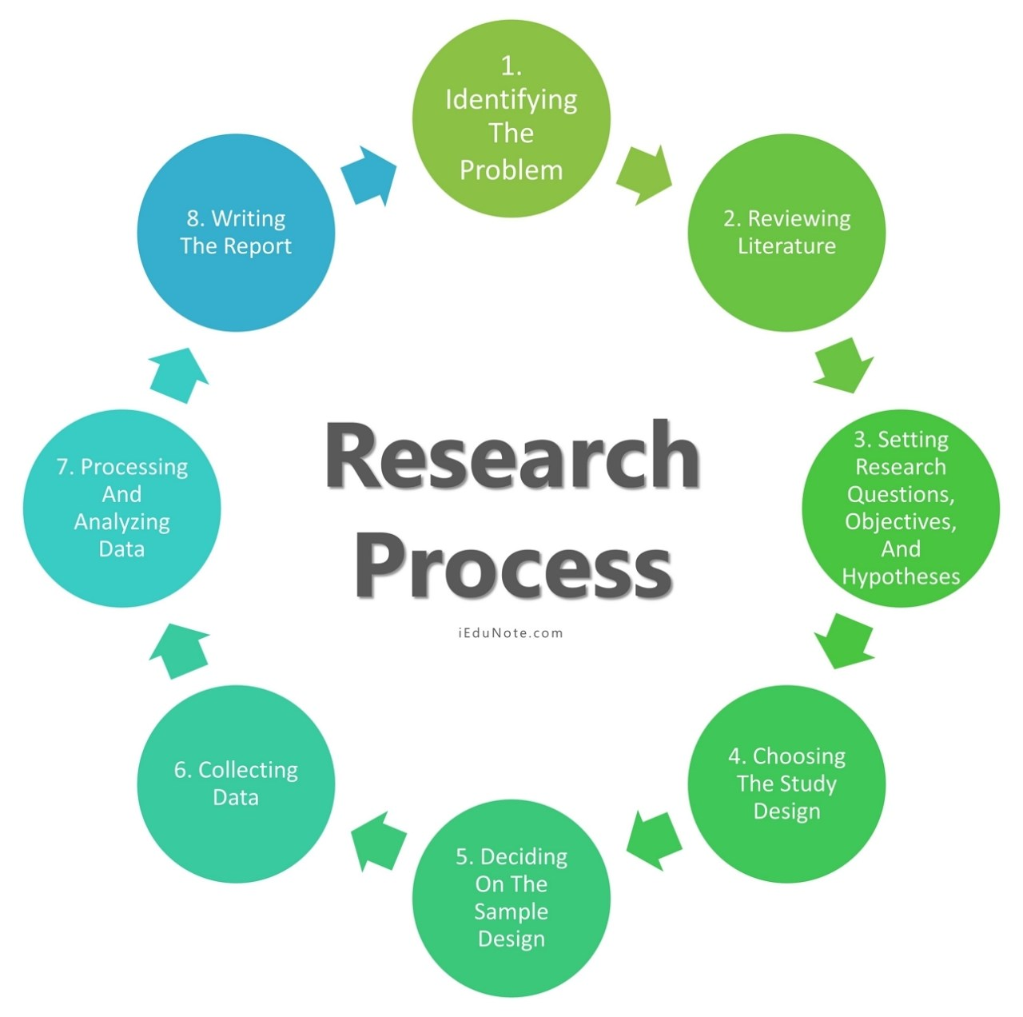

Slide 4
The research process outlined above is, in essence, part and parcel of a research proposal. It is an outline of your commitment that you intend to follow in executing a research study.
A close examination of the above stages reveals that each of these stages, by and large, is dependent upon the others. One cannot analyze data (step 7) unless he has collected data (step 6). It is also true that one cannot write a report (step 8) unless he has collected (Step 6)and analyzed data (step 7). Research then is a system of interdependent related stages.

Slide 5
A research process can be compared with a route map. The map analogy is useful for the researcher because at each stage of the research process, and there are several alternatives to follow.
Choosing the best alternative in terms of time constraints, money, and human resources in our research decision is our primary goal.

Slide 6
The key to a successful research project ultimately lies in iteration: the process of returning again and again to the identification of the research problems, methodology, data collection, etc. which lead to new ideas, revisions and improvements.

Slide 7
Step – 1: Identifying the Problem
The first and foremost task in the entire process of scientific research is to identify a research problem. But the core question is: whether all problems require research. We have countless problems around us, but all that we encounter do not qualify as research problems, and thus, these do not need to be researched.

Slide 8
Keeping this point in view, we must draw a line between a research problem and a non-research problem. Intuitively, researchable problems are those who have a possibility of thorough verification investigation, which can be effected through the analysis and collection of data, while the non-research problems do not need to go through these processes.

Slide 9
Non-Research Problem
A non-research problem is one that does not require any research to arrive at a solution. Intuitively, a non-researchable problem consists of vague details and cannot be resolved through research. It is a managerial or built-in problem that may be solved at the administrative or management level.

Slide 10
The outbreak of cholera, for example, following a severe flood, is a common phenomenon in many communities. The reason for this is known. It is thus not a research problem.
Similarly, reasons for the sudden rise in prices of many essential commodities following the announcement of the budget by the Finance Minister need no investigation. Hence it is not a problem that needs research.

Slide 11
Example #1
A recent survey in District A found that 1000 women were continuous users of contraceptive pills. But last month’s service statistics indicate that none of these women were using contraceptive pills (Fisher et al. 1991:4). The discrepancy is that ‘all 1000 women should have been using a pill, but in fact, none is doing so. The question is: why the discrepancy exists? Well, the fact is, a monsoon flood has prevented all new supplies of pills reaching District A, and all old supplies have been exhausted. Thus, although the problem situation exists, the reason for the problem is already known. Therefore, assuming that all the facts are correct, there is no reason to research the factors associated with pill discontinuation among women. Is this a Research problem?

Slide 12
Example #2
A pilot survey by Dhaka University revealed that in Raipura Upazila, the goiter prevalence among the school children is as high as 80%, while in the neighboring Upazila, it is only to the extent of 30%. Why is this discrepancy? Upon inquiry, it was seen that some three years back, UNICEF launched a lipiodol injection program in the neighboring Upazila. This attempt acted as a preventive measure against goiter. The reason for the discrepancy is thus therefore known, IS THIS A RESEARCH PROBLEM

Slide 13
Example #3
A hospital treated a large number of cholera cases with penicillin, but the treatment with penicillin was not found to be effective. Do we need research to know the reason? Here again, there is one single reason that Vibrio cholera is not sensitive to penicillin, and therefore, this is not the drug of choice for this disease. In this case, too, as the reasons are known, it is unwise to undertake any study to find out why penicillin does not improve the condition of cholera patients. Is this a research problem?

Slide 14
Example #4
In the tea marketing system, buying and selling tea starts from bidders. Blenders purchase open tea from the bidders. It is observed over the years that marketing cost is the highest for bidders, while it is the lowest for the blenders. What makes this difference? The fact is that the bidders pay exorbitantly higher transport costs, which constitutes about 30% of their total cost. Blenders have significantly fewer marketing functions involving transportation, and hence their marketing cost remains at a minimum. Is this a research problem?

Slide 15
Here are some of the problems we frequently encounter, which may well be considered as non-research problems:
Rises in the price of warm clothes during winter;
Preferring admission in public universities over private universities;
Crisis of accommodations in sea resorts during summer
Traffic jam in the city street after office hours;
High sales in department stores after an offer of a discount.

Slide 16
Research Problem
In contrast to a non-research problem, a research problem is of primary concern to a researcher. A research problem is a perceived difficulty, a feeling of discomfort, or a discrepancy between the common belief and reality. As noted by Fisher et al. (1993), a problem will qualify as a potential research problem when the following three conditions exist:

Slide 17
There should be a perceived discrepancy between “what it is” and “what it should have been.” This implies that there should be a difference between “what exists” and the “ideal or planned situation”;
A question about “why” the discrepancy exists. This implies that the reason(s) for this discrepancy is unclear to the researcher (so that it makes sense to develop a research question); and
There should be at least two possible answers or solutions to the questions or problems.

Slide 18
The third point is important. If there is only one possible and plausible answer to the question about the discrepancy, then a research situation does not exist. It is a non-research problem that can be tackled at the managerial or administrative level.

Slide 19
Example #1
While visiting a rural area, the UNICEF team observed that some villages have female school attendance rates as high as 75%, while some have as low as 10%, although all villages should have a nearly equal rate of attendance. What factors are associated with this discrepancy?

Slide 20
We may enumerate several reasons for this:
Villages differ in their socio-economic background.
In some villages, the Muslim population constitutes a large proportion of the total population. Religion might play a vital role.
Schools are far away from some villages. The distance thus may make this difference.
Because there is more than one answer to the problem, it is considered a research problem, and a study can be undertaken to find a solution.

Slide 21
Example#2
The Government of Bangladesh has been making all-out efforts to ensure regular flow of credit in rural areas at a concession rate through liberal lending policy and establishing a large number of bank branches in rural areas. Knowledgeable sources indicate that expected development in rural areas has not yet been achieved mainly because of improper utilization of the credit. More than one reason is suspected of such misuse or misdirection.

Slide 22
These include, among others:
Diversion of credit money to some unproductive sectors
Transfer of credit money to other people like money lenders, who exploit the rural people with this money
Lack of knowledge of proper utilization of the credit.
Here too, reasons for misuse of loans are more than one. We thus consider this problem as a researchable problem.

Slide 23
Example #3
On the 20th day of December 2010, almost all the locals came up with a news headline of the form: Dhaka Stock Exchange (DSE) observes the steepest ever fall in stock prices: several injured as retail investors clash with police, vehicles ransacked’. Investors’ demonstration, protest and clash with police pause a problem, but it is certainly not a research problem since there is only one known reason for the problem: DSE experiences the steepest fall in stock prices. But what causes this unprecedented fall in the share market? Experts felt that no single reason could be attributed to the problem. It is a mix of several factors, and hence it is a research problem.

Slide 24
The following were assumed to be some of the possible reasons:
The merchant banking system;
Liquidity shortage because of the hike in the rate of cash reserve requirement (CRR);
IMF’s warnings and prescriptions on the commercial banks’ exposure to the stock market;
Increase in supply of new shares;
Manipulation of share prices;
Lack of knowledge of the investors on the company’s fundamentals.

Slide 25
The choice of a research problem is not as easy as it appears. It is generally guided by the researchers;
Own intellectual orientation,
Level of training,
Experience,
Knowledge on the subject matter, and
Intellectual curiosity.

Slide 26
Theoretical and practical considerations also play a vital role in choosing a research problem. Societal needs also guide to choose a research problem. Once we have chosen a research problem, a few more related steps are required to be followed before a decision is taken to undertake a research study.

Slide 27
Steps followed before research
These include, among others, the following:
Statement of the problem.
Justifying the problem.
Analyzing the problem.
A detailed exposition of these issues is undertaken later while discussing the proposal development.

Slide 28
Statement of the Problem
A clear and well-defined statement of the problem is considered as the foundation for the development of the research proposal. It enables the researcher to systematically point out why the proposed research on the problem should be undertaken and what he/she hopes to achieve with the findings of the study. A well-defined statement of the problem will lead the researcher to formulate the research objectives, to understand the background of the study, and to choose a proper research methodology.

Slide 29
Justifying the Problem
Once the problem situation has been identified and clearly stated, it is important to justify the importance of the problem. In justifying the problems, we ask such questions as to; why the problem of the study is important, how large and widespread is the problem, can others be convinced about the importance of the problem and the like. Answers to the above questions should be reviewed and presented in one or two paragraphs that justify the importance of the problem.

Slide 30
Analyzing the Problem
As a first step of analyzing the problem, critical attention should be given to accommodate the viewpoints of the managers, users, and the researchers to the problem through threadbare discussions. The next step is to identify the factors that may have contributed to the perceived problems.

Slide 31
Other Issues of Problem Identification
After identifying, defining, and analyzing a problem, there are several ways of obtaining insights and getting a clearer idea about these issues.
Exploratory research is one of the ways of accomplishing this. The purpose of the exploratory research process is to progressively narrow the scope of the topic and to transform the undefined problems into defined ones, incorporating specific research objectives.

Slide 32
The exploratory study entails a few basic strategies in gaining insights into the problem. It is accomplished through such efforts as:
Pilot survey
Case studies
Focus group interview and
Experience survey

Slide 33
Pilot Survey
A pilot survey collects proxy data from the ultimate subjects of the study to serve as a guide for the large study. A pilot study generates primary data, usually for qualitative analysis. This characteristic distinguishes a pilot survey from secondary data analysis, which gathers background information.

Slide 34
Case Studies
Case studies are quite helpful in the diagnosis of a problem and paving the way to defining the problem. Case studies intensively investigate one or a few situations identical to the researcher’s problem situation.

Slide 35
Focus Group Interviews
Focus group interviews, an unstructured free-flowing interview with a small group of people, may also be conducted to understand and define a research problem.

Slide 36
Experience Survey
Experience survey is another strategy to deal with the problem of identifying and defining the research problem.
It is an exploratory research endeavor, in which individuals who are knowledgeable and experienced about a particular research problem are intimately consulted in an attempt to understand the problem.
These persons are sometimes known as key informants, and an interview with them is popularly known as the Key Informant Interview (KII).

Slide 37
Step – 2: Reviewing of Literature
A review of relevant literature is an integral part of the research process. It enables the researcher to formulate his problem in terms of the specific aspects of the general area of his interest that has not been so far researched. Such a review, not only provides him exposure to a larger body of knowledge but also equips him with enhanced knowledge to efficiently follow the research process.

Slide 38
Through a proper review of the literature, the researcher may develop the coherence between the results of his study and those of the others.
If the researcher is aware of earlier studies of his topic, or related topics, he will be in a much better position to assess the significance of his work and to convince others that it is important.

Slide 39
Why carry out Literature Review
It avoids duplication of the work that has been done in the recent past.
It helps the researcher to find out what others have learned and reported on the problem.
It helps the researcher to become familiar with the types of methodology followed by others.
It helps the researcher to understand what concepts and theories are relevant to his area of investigation.

Slide 40
It helps the researcher to understand if there are any significant controversies, contradictions, and inconsistencies in findings.
It allows the researcher to understand if there are any unanswered research questions.
It might help the researcher to develop an analytical framework.
It will help the researcher to consider the inclusion of variables in his research that he might not otherwise have thought about.

Slide 41
Step – 3: Setting research questions, objectives, and hypotheses
After discovering and defining the research problem, researchers should make a formal statement of the problem leading to research objectives.

Slide 42
An objective will precisely say what should be researched, to delineate the type of information that should be collected, and provide a framework for the scope of the study. The best expression of a research objective is a well-formulated, testable research hypothesis.
A hypothesis is an unproven statement or proposition that can be refuted or supported by empirical data. Hypothetical statements assert a possible answer to a research question.

Slide 43
Step -4: Choosing the study design
The research design is the blueprint or framework for fulfilling objectives and answering research questions. It is a master plan specifying the methods and procedures for collecting, processing, and analyzing the collected data. There are four basic research designs that a researcher can use to conduct his or her study;

Slide 44
Survey,
Experiment,
Secondary data study, and
Observational study.

Slide 45
The type of research design to be chosen from among the above four designs depends primarily on four factors:
The type of problem
The objectives of the study,
The existing state of knowledge about the problem that is being studied, and
The resources are available for the study.

Slide 46
Step – 5: Deciding on the sample design
The basic idea of sampling is that it involves any procedure that uses a relatively small number of items or portions (called a sample) of a universe (called population) to conclude the whole population.

Slide 47
It contrasts with the process of complete enumeration, in which every member of the population is included. Such a complete enumeration is referred to as census.
A population is the total collection of elements about which we wish to make some inference or generalization.
A sample is a part of the population, carefully selected to represent that population.

Slide 48
If certain statistical procedures are followed in selecting the sample, it should have the same characteristics as the population as a whole. These procedures are embedded in the sample design.
Sample design refers to the methods to be followed in selecting a sample from the population and the estimating technique, vis-a-vis formula for computing the sample statistics.

Slide 49
The basic question is, then, how to select a sample? To answer this question, we must have acquaintance with the sampling methods.
These methods are basically of two types: probability sampling and non-probability sampling. Probability sampling ensures every unit has a known nonzero probability of selection within the target population. If there is no feasible alternative, a non-probability sampling method may be employed.

Slide 50
The basis of such selection is entirely dependent on the researcher’s discretion. This approach is variously called judgment sampling, convenience sampling, accidental sampling, and purposive sampling.

Slide 51
Probability Sampling
The most widely used probability sampling methods are simple random sampling, stratified random sampling, cluster sampling, and systematic sampling. They have been classified by their representation basis and unit selection techniques.

Slide 52
Two other variations of the sampling methods that are in great use are multistage sampling and probability proportional to size (PPS) sampling. Multistage sampling is most commonly used in drawing samples from very large and diverse populations. The PPS sampling is a variation on multistage sampling in which the probability of selecting a cluster is proportional to its size, and an equal number of elements are sampled within each clust

Slide 53
Step – 6: Collecting data
The gathering of data may range from simple observation to a large-scale survey in any defined population.
There are many ways to collect data. The approach selected depends on the objectives of the study, the research design, and the availability of time, money, and personnel.
With the variation in the type of data (qualitative or quantitative) to be collected, the method of data collection also varies. The most common means for collecting quantitative data is the structured interview.

Slide 54
Studies that obtain data by interviewing respondents are called surveys. Data can also be collected by using self-administered questionnaires. Telephone interviewing is another way in which data may be collected.
Other means of data collection include the use of secondary sources, such as the census, vital registration records, official documents, previous surveys, etc. Qualitative data are collected mainly through in-depth interviews, focus group discussions, KII, and observational studies.

Slide 55
Step-7: Processing and Analyzing Data
Data processing generally begins with the editing and coding of data. Data are edited to ensure consistency across respondents and to locate omissions, if any.
In survey data, editing reduces errors in the recording, improves legibility, and clarifies unclear and inappropriate responses. In addition to editing, the data also need coding.
Because it is impractical to place raw data into a report, alphanumeric codes are used to reduce the responses to a more manageable form for storage and future processing.

Slide 56
This coding process facilitates processing the data. The personal computer offers an excellent opportunity in data editing and coding processes.
Data analysis usually involves reducing accumulated data to a manageable size, developing summaries, searching for patterns, and applying statistical techniques for understanding and interpreting the findings in the light of the research questions.

Slide 57
Further, the researcher, based on his analysis, determines if his findings are consistent with the formulated hypotheses and theories.
The techniques to be used in analyzing data may range from simple graphical technique to very complex multivariate analysis depending on the objectives of the study, research design employed, and the nature of data collected.
As in the case of methods of data collection, an analytical technique appropriate in one situation may not be appropriate for another.

Slide 58
Step-8: Writing the report – Developing Research Proposal, Writing Report, Disseminating and Utilizing Results
The entire task of a research study is accumulated in a document called a proposal.
A research proposal is a work plan, prospectus, outline, an offer, a statement of intent or commitment from an individual researcher or an organization to produce a product or render a service to a potential client or sponsor.
The proposal will be prepared to keep in view the sequence presented in the research process.

Slide 59
The proposal tells us what, how, where, and to whom it will be done.
It must also show the benefit of doing it. It always includes an explanation of the purpose of the study (the research objectives) or a definition of the problem.
It systematically outlines the particular research methodology and details the procedures that will be utilized at each stage of the research process.

Slide 60
The end goal of a scientific study is to interpret the results and draw conclusions.
To this end, it is necessary to prepare a report and transmit the findings and recommendations to administrators, policymakers, and program managers for the intended purpose of making a decision.
There are various forms of research reports: term papers, dissertations, journal articles, papers for presentation at professional conferences and seminars, books, and so on.
The results of a research investigation prepared in any form are of little utility if they are not communicated to others.

Slide 61
The primary purpose of a dissemination strategy is to identify the most effective media channels to reach different audience groups with study findings most relevant to their needs.
The dissemination may be made through a conference, a seminar, a report, or an oral or poster presentation.
The style and organization of the report will differ according to the target audience, the occasion, and the purpose of the research. Reports should be developed from the client’s perspectives.

Slide 62
A report is an excellent means that helps to establish the researcher’s credibility. At a bare minimum, a research report should contain sections on:
An executive summary;
Background of the problem;
Literature review;
Methodology;
Findings;
Discussion;
Conclusions and
Recommendations.

Slide 63
The results of the study can also be disseminated through peer-reviewed journals published by academic institutions and reputed publishers both at home and abroad.
These journals have their format and editorial policies.
The contributors can submit their manuscripts adhering to the policies and format for possible publications of their papers.
There are now ample opportunities for the researchers to publish one’s work online as well.

Slide 64
Many interesting studies have been conducted by the researchers without having any effect in actual settings.
Ideally, the concluding step of a scientific study is to plan for its utilization in the real world.
Although researchers are often not themselves in a position to implement a plan for utilizing research findings, they can contribute to the process by including in their research reports a few recommendations regarding how the results of the study could be utilized for policy formulation and program intervention.

Slide 65
Recap
Question
Define the conceptual framework and how significant is it to the design of research proposal?

